Slide 1

Beamforming techniques
Eelke Spaak

Slide 2

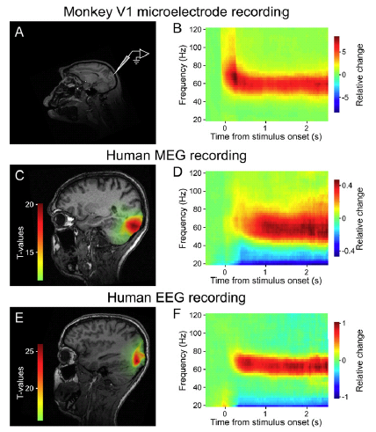

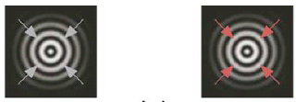
Examples

Slide 3
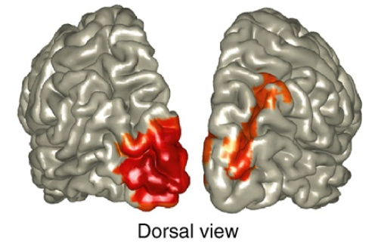
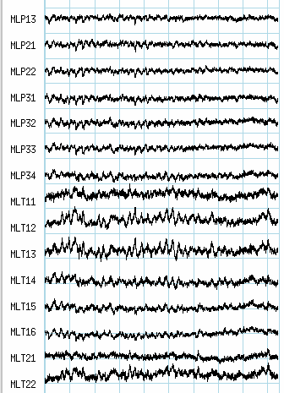
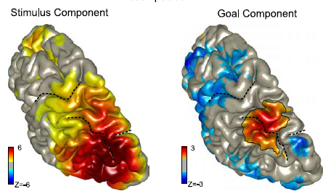
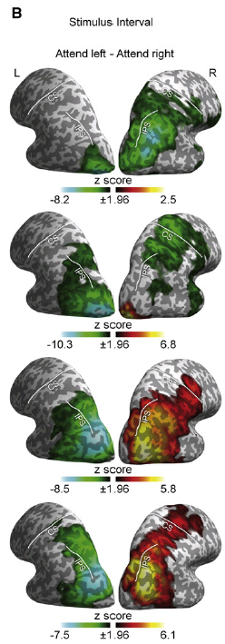
How did the brain get these red and blue blobs?
This lecture will explain how you get from:
to

Slide 4
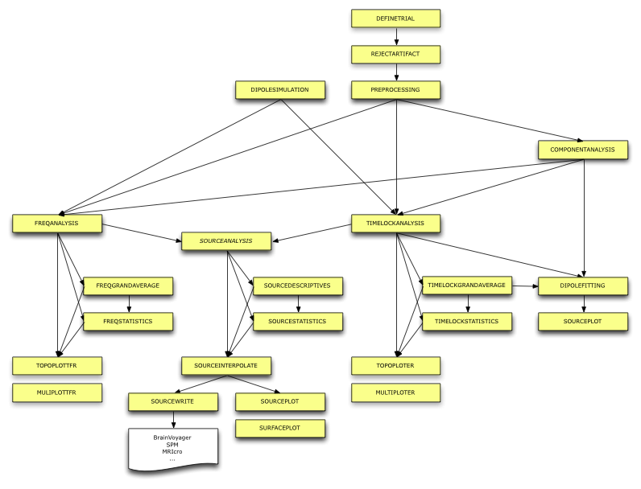
Fieldtrip functions for source localization

Slide 5
Source localization
Different algorithms on the market
Several of these are implemented in FieldTrip
cfg = [];
.
source = ft_dipolefitting(cfg, data);
cfg = [];
cfg.method = ‘mne’;
.
.
.
source = ft_sourceanalysis(cfg, data);
cfg = [];
cfg.method = ‘lcmv’;
.
.
.
source = ft_sourceanalysis(cfg, data);
cfg = [];
Cfg.method = ‘dics’;
.
.
.
source = ft_sourceanalysis(cfg, freq);
Beamformers

Slide 6
Procedure beamforming of oscillatory activity
Design experiment
Measure brain activity during experiment
Data analysis
Preprocessing etc.
Time frequency analysis
Source analysis

Slide 7
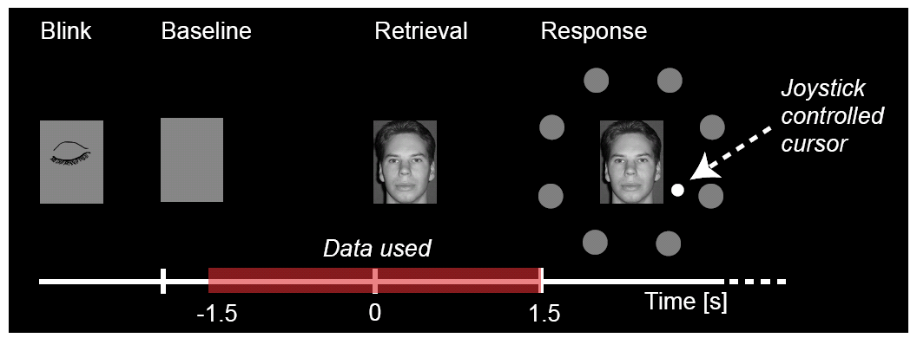
Stage 1: Design experiment
Baseline recommendable
Sufficient length of stationary signal
Response not too soon
Avoid artifacts
Eyeblink stimulus
Experiment not too long, or introduce breaks (muscle artifacts)

Slide 8
Stage 2: Measuring brain activity
Record EOG (or eye tracking) and ECG to remove artifacts
Measure positions sensors/electrodes in relation to head
Reduce head movement (MEG)
Make anatomical MRI scan for realistic head model and optimal normalization over subjects
Perform if applicable and possible localizer task

Slide 9
Stage 3: Data analysis: Preprocessing
Data segmentation
Artifact removal

Slide 10
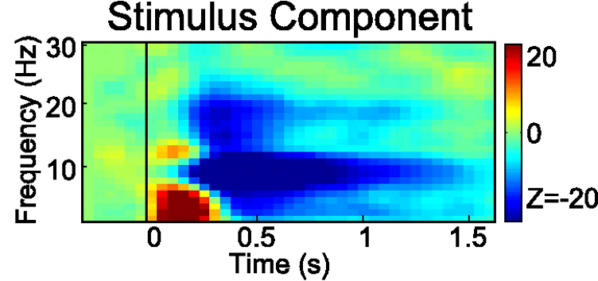
Stage 3: Data analysis: Time frequency analysis
“Beam” this time-frequency tile
0.1 to 1.1 s
~10 Hz

Slide 11
Recap: Time-frequency relation
The frequency resolution is determined by the length of the time window T
Raleigh frequency = 1/T = frequency resolution
Time window:
1 s
Frequencies:
1 2 3 4 5 6 .. Hz
Time window:
0.2 s
Frequencies:
5 10 15 20 .. Hz

Slide 12
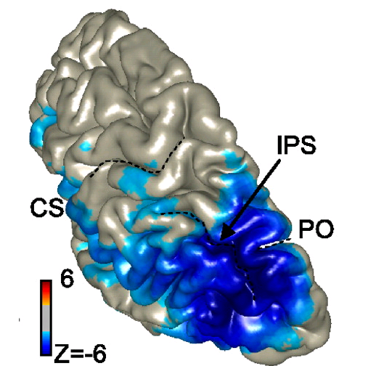
Stage 3: Data analysis: Time frequency analysis
Time window of 1 second:
Frequency resolution 1 Hz
Bandwidth: 9.5 – 10.5 Hz

Slide 13
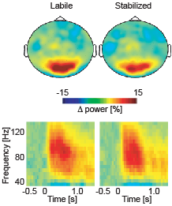
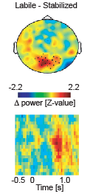
Stage 3: Data analysis: Time frequency analysis
“Beam” this time-frequency tile
0.7 to 0.9 s 70 to 90 Hz

Slide 14

Stage 3: Data analysis: Time frequency analysis
I want:
“Beam” this time-frequency tile
0.7 to 0.9 s 70 to 90 Hz
Increase frequency smoothing without changing length time window: multitapers
I get:
0.2 s ↓ 5 Hz resolution ↓ 77.5 - 82.5 Hz

Slide 15
Recap: multitapers
More tapers for a given time window will result in more spectral smoothing
Several orthogonal tapers are used for the time window, subsequently the power (and phase) is calculated for each tapered data segment and then combined.
0.2 s
5 tapers
65 – 95 Hz
cfg = [];
cfg.method = ‘mtmconvol’;
cfg.output = ‘powandcsd’;
cfg.toi = 0.8;
cfg.foi = 80;
cfg.t_ftimwin = 0.2;
cfg.tapsmofrq = 15;
freq = ft_freqanalysis(cfg, data);

Slide 16
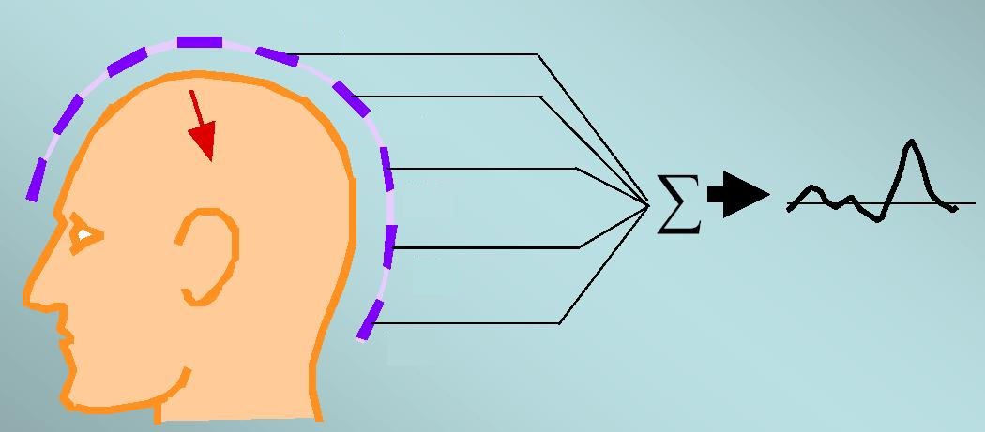
Beamformer: the question
What is the activity of a source s, at a location r, given the data x?
Note: the explanation is in the time domain, because that is more intuitive
We estimate s with a spatial filter w
x₁(t)
H₁
x₂(t)
w_{1r}
H₂
x₂(t)
w_{2r}
h₁
H₃
y_{r}(t)
h₂
x₃(t)
s_{r}
x₃(t)
w_{3r}
h₃
H₄
x₄(t)
h₄
s_{r}(t) = Σ _{i=1:n}w(r) x(t)
x₄(t)
w_{4r}
H₅
^
h₅
x₅(t)
s_{r} (t) = w(r)^{T} x(t)
x₅(t)
w_{5r}

Slide 17
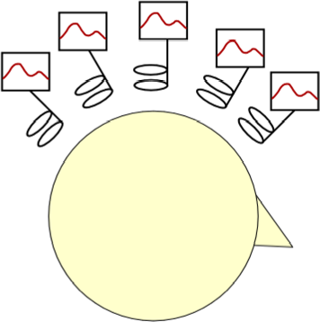
Beamformers: the concept

Slide 18
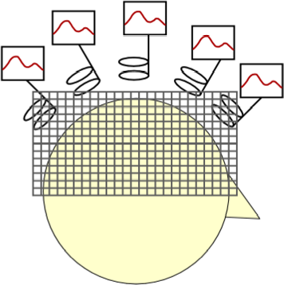
Beamformers: the concept
Notes:
18

Slide 19
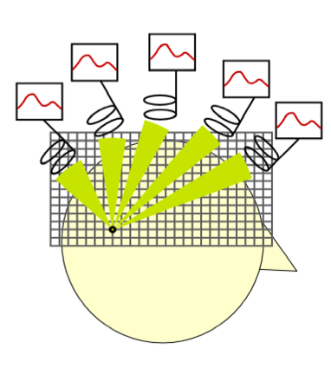
Beamformers: the concept
Notes:
19

Slide 20
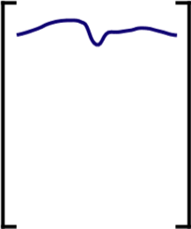
Beamformers: the concept
Notes:
20

Slide 21
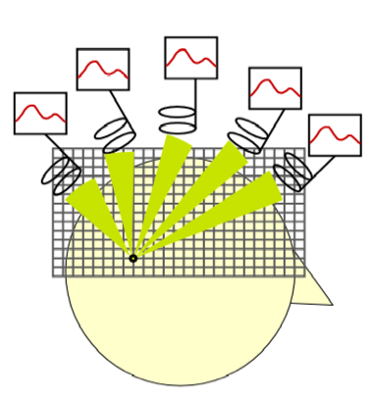


Beamformers: the concept
Notes:
21

Slide 22
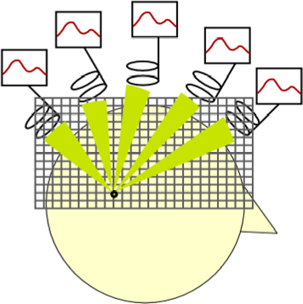


Beamformers: the concept
Notes:
22

Slide 23



Beamformers: the concept
Notes:
23

Slide 24
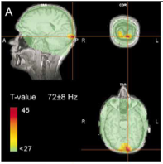
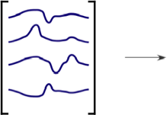
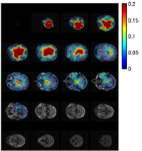
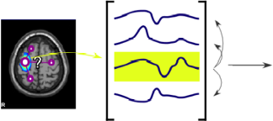
And then: creating the blobs
Statistical test
(or thresholding)
Connectivity analysis
Notes:
24

Slide 25
Beamformer ingredients
Forward model
Predict the data from a source at a given location
Ensures specificity in space (spotlight)
Experimental data
Experimental contrast / active versus baseline
Ensures selectivity for effect of interest
Notes:
25
25

Slide 26
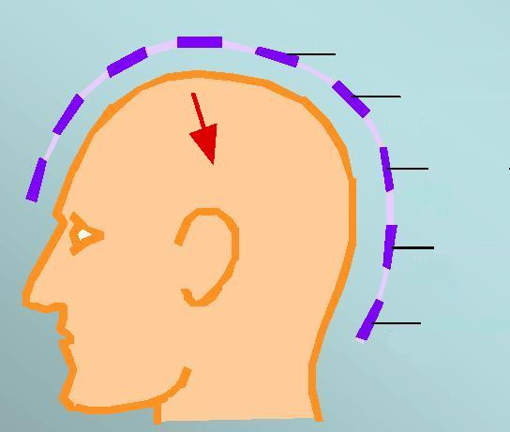
Beamformer ingredients: forward model
Forward model
How is a source ‘seen’ by the sensor-array?
Given a source s at location r (and orientation η), what is the data x?
Notes:
26
26

Slide 27
Beamformer ingredients: forward model
Forward model
How is a source ‘seen’ by the sensor-array?
Given a source s at location r (and orientation η), what is the data x?
Leadfield
x₁(t)
time →
H₁
H₂
x₂(t)
X(t)
h_{r}
h₁
y_{r}(t)
h₂
H₃
time →
s_{r}
x₃(t)
h₃
← channels
=
?
*
s_{r}(t)
H₄
← channels
h₄
x₄(t)
H₅
h₅
x₅(t)
X = h * s
Notes:
27
27

Slide 28
Beamformer ingredients: forward model
Sensor positions
Where is the brain with respect to the sensors?
Notes:
28
28

Slide 29
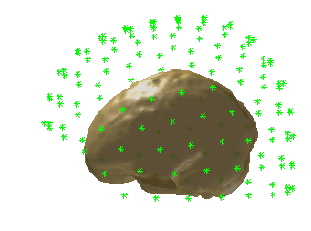
Beamformer ingredients: forward model
cfg = [];
cfg.method = ‘dics’;
.
.
.
.
source = ft_sourceanalysis(cfg, freq);
Sensor positions
Where is the brain with respect to the sensors?
Position of the head in the MEG-helmet / electrodes on the scalp
elec = ft_read_sens(‘somefile’)
elec.elecpos = [Mx3]
elec.label = {Nx1}
elec.tra = [MxN]
cfg.elec = elec;
source = ft_sourceanalysis(cfg, freq);
freq.grad
freq.grad.coilpos = [Mx3]
freq.grad.coilori = [Mx3]
freq.grad.label = {Nx1}
freq.grad.tra = [MxN]
fiducials
Notes:
29
29

Slide 30
Beamformer ingredients: forward model
cfg = [];
cfg.method = ‘dics’;
.
.
.
.
source = sourceanalysis(cfg, freq);
cfg = [];
cfg.method = ‘dics’;
cfg.grid = sourcemodel;%create one
. %yourself, or
. %let fieldtrip
. %do it for you
source = sourceanalysis(cfg, freq);
Grid positions
Which locations do you want to ‘scan’?
Notes:
30
30

Slide 31
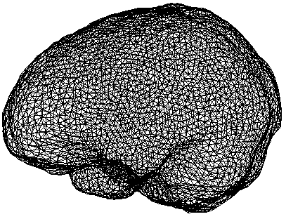
Beamformer ingredients: forward model
cfg = [];
cfg.method = ‘dics’;
cfg.grid = sourcemodel;
cfg.vol = hdm; %create one
. %yourself
.
source = sourceanalysis(cfg, freq);
Volume conductor model
What is the shape of the volume in which current is flowing?
Notes:
31
31

Slide 32
Beamformer ingredients: forward model
cfg = [];
cfg.method = ‘dics’;
cfg.grid = sourcemodel;
cfg.vol = hdm;
.
.
source = sourceanalysis(cfg, freq);
Forward model
h = leadfield matrix
h_{r}
Notes:
32
32

Slide 33
Beamformer: the question revisited
What is the activity of a source s, at a location r, given the data X?
We know how to get from source to data: X = h * s
We want to go from data to source: w^{T} * X = s
w^{T} is called a spatial filter
^
x₁(t)
H₁
x₂(t)
w_{1r}
H₂
x₂(t)
w_{2r}
h₁
H₃
y_{r}(t)
h₂
x₃(t)
s_{r}
x₃(t)
w_{3r}
h₃
H₄
x₄(t)
h₄
s_{r}(t) = Σ _{i=1:n}w(r) x(t)
x₄(t)
w_{4r}
H₅
^
h₅
x₅(t)
s_{r} (t) = w_{r}^{T} x(t)
x₅(t)
w_{5r}
X
w^{T}
=
^
s
Notes:
33

Slide 34
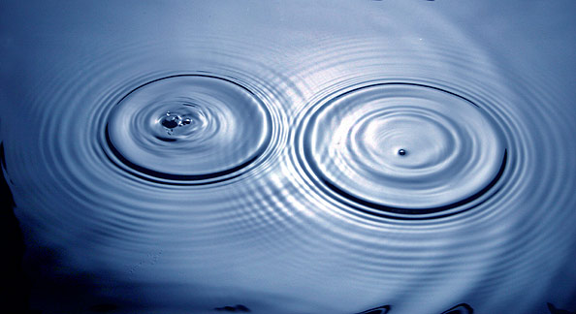
Beamformer: the inverse problem

Slide 35
Beamformer: the inverse problem
What should this spatial filter (w^{T}) take into account?
h_{i}
Cov
No cofluctuation → we can suppress
w^{T} = [h^{T} Cov⁻¹h]⁻¹ h^{T} Cov⁻¹
^
w^{T} * X = s

Slide 36
Beamformer ingredients
Forward model
Volume conduction model (typically using MRI)
Sensor positions
Grid points to ‘scan’
Experimental data
Time domain: covariance
Frequency domain: cross-spectral density
freq =
freq.grad = …
freq.crsspctrm = …
cfg = [];
cfg.method = ‘dics’;
cfg.grid = grid;
cfg.vol = vol;
.
.
source = ft_sourceanalysis(cfg, freq);

Slide 37
Strengths of beamforming
Easier to average over subjects (compared to dipole methods)
Suitable for SPM-like statistics
Because source estimation at each point independent of other points
Subject 1
Subject 2
No a priori assumptions about amount of sources or locations of sources

Slide 38
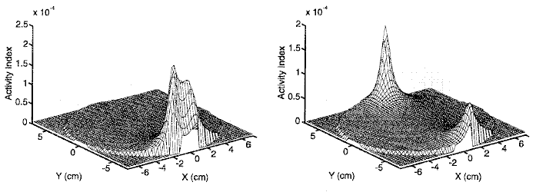
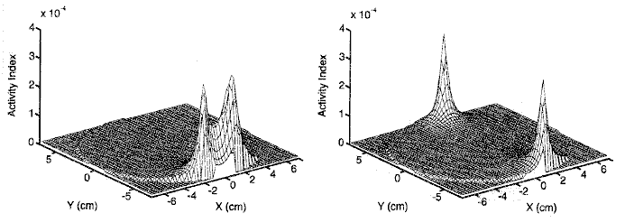
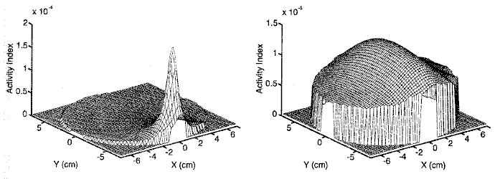
Limitation of beamforming
Sources should not be too correlated
mildly correlated sources
uncorrelated sources, van Veen et al. (1997)
perfectly correlated sources

Slide 39
Summary
Beamforming
Scanning method, each point is estimated independently
Inverse modeling by spatial filter
Unifies two constraints:
(1) pass all activity at location of interest while
(2) suppressing as much activity (i.e. noise, other sources) as possible
Makes use of covariance of data, and forward model
Both possible in time and frequency domain
No a priori assumptions about source configurations
Applicable in very many scenarios
Except when you have good reason to expect strongly correlated sources

